Slide 1

Real-Time Face Recognition System with Custom-Trained Deep Learning Models
Graduation Project Presentation
Team Members:
Ahmed Kamal FathAllah (17010210)
George Seleim Abd-Allah Khaleel (20010436)
Supervisors:
Dr. Magdy Abdel-Azeem
Dr. Salah Selim
Computer Science and Engineering Department, Alexandria University

Slide 2
Introduction & Motivation
Growing Need: Facial recognition is a leading biometric technology used in security, access control, and personalized services. It offers a more seamless solution than traditional methods like passwords or ID cards.
The Problem: Off-the-shelf systems are often static and perform poorly in varied, real-world conditions (e.g., low-light, different camera qualities). There is a need for a flexible system that allows users to balance performance and accuracy based on available resources.
Our Solution: A complete, user-centric system that allows for the dynamic selection of face detection models and camera sources to adapt to different environments.

Slide 3



Our Core Objectives
Develop a Complete Pipeline: To design and implement a comprehensive, real-time face recognition system from image acquisition to final identification.
Integrate Multiple Detectors: To integrate and allow comparison between three distinct face detection models: YuNet, Haar Cascade, and a custom-trained CNN.
Train a High-Accuracy Recognition Model: To train a robust face recognition model using a ResNet-based architecture and an ArcFace loss function to generate highly discriminative facial embeddings.
Build an Intuitive GUI: To create a user-friendly interface for managing camera sources (Webcam, ESP32-CAM), switching models, and overseeing a database of registered users.

Slide 4
Scope of the Project
In Scope:
A modular software application developed in Python.
Integration of built-in webcams and IP-based ESP32-CAMs.
Training and comparison of three different face detection algorithms.
Use of a local SQLite database for user management and storing facial embeddings.
Out of Scope:
Anti-spoofing mechanisms to detect liveness (e.g., using a photo or mask).
Large-scale, cloud-based deployment or distributed database management.
Complex face tracking to follow a person moving across the frame.
Detection of multiple faces in a single frame.

Slide 5
High-Level System Architecture
Our system is built on a modular Python architecture, separating core functionalities for maintainability and scalability.
YuNet
Haar Cascade
Custom CNN
Camera Feed (Built-in / ESP32)
Frame Pre-processing (OpenCV)
Face Detection
Face Cropping & Alignment
GUI Output (CustomTkinter)
Database Matching (SQLite)
Embedding Generation (Custom Recognition Model)

Slide 6
System Features
Real-time Performance: Continuous detection and recognition from live video.
Configurable Sources: Easily switch between webcam and IP camera (ESP32).
Multi-Model Support: Dynamically select the best face detector for the task.
User Management: Register new individuals, grant/revoke access, and delete profiles via the GUI.
Robust Recognition: Uses embedding averaging for improved accuracy with fluctuating video quality.
Real-time Feedback: GUI displays live camera feed, recognition results, and match confidence.

Slide 7



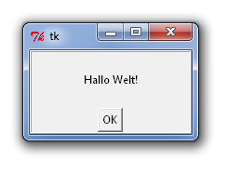


Technologies Used
Python: Core programming language.
PyTorch: For deep learning model training and inference.
OpenCV: For real-time computer vision tasks.
CustomTkinter: For the modern graphical user interface.
SQLite: For lightweight, on-device database management.
NumPy & PIL: For numerical operations and image processing.

Slide 8



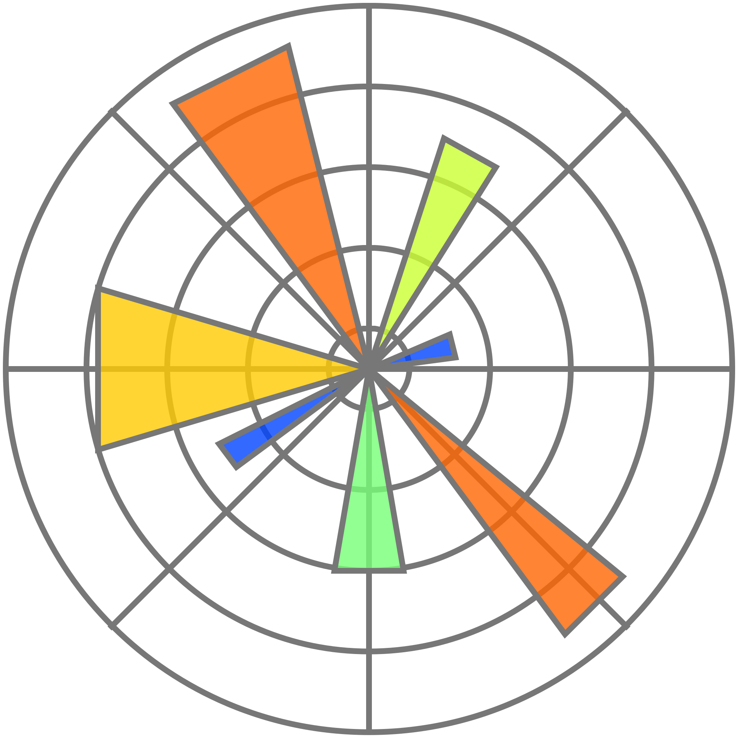



Technologies Used
albumentations (Crucial for data augmentation in notebooks)
datasets (Used in to download CelebA dataset form Hugging Face)
pandas, matplotlib (For data analysis and visualization in notebooks)
scikit-learn, scipy (For metrics, clustering, etc., in notebooks)
umap-learn (For visualization in arkface_residual_connections_part_2 testing notebook)

Slide 9
Step 1: Face Detection Models
Custom CNN:
Architecture: A 5-Layered conv model trained on the CelebA dataset.
Benefit: Optimized for specific, high-quality image conditions.
Limitation: Computationally intensive and less robust in noisy, real-world video streams.
Haar Cascade:
Method: Based on the classic Viola-Jones algorithm.
Benefit: Extremely fast and lightweight, ideal for systems with limited computational resources.
Limitation: Less accurate and highly sensitive to changes in pose and lighting.
YuNet:
Method: Lightweight deep learning model.
Benefit: Provides an excellent balance of speed and accuracy, making it robust to variations in image quality. It is our recommended default detector.

Slide 10
Step 2: Face Recognition (Embedding Generation)
Concept: We convert each detected face into a unique 512-dimension numerical vector called an "embedding." The cosine distance between two embeddings determines their similarity.
Model: A custom-trained ResNet-inspired model, named ResArkSGD.
Architecture: Features deep residual connections to facilitate robust training.
Training Dataset: Trained on the medium-scale VGGFace2-HQ-Cropped dataset.
Key Technology: ArcFace Loss:
Function: This advanced loss function works by maximizing the angular distance between different identities in the feature space.
Advantage: It produces more discriminative and generalizable embeddings compared to other functions like standard Softmax or Triplet Loss, leading to higher accuracy.

Slide 11
Model Training & Performance
Training Environment: Experiments were conducted on Kaggle using NVIDIA Tesla T4 GPUs.
Recognition Model Training: The resarksgdaug94 model, which included data augmentation, demonstrated the best overall performance.
It achieved the lowest validation loss (approx. 1.1) and a sustained high accuracy of 94%.
The training curves show a healthy convergence, with training loss consistently decreasing while validation loss remains low and stable.

Slide 12
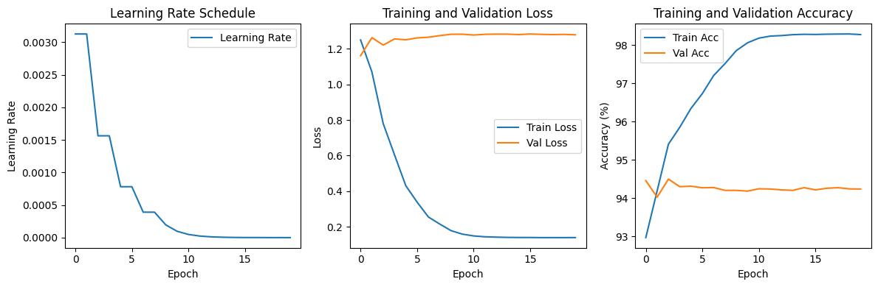
the training curve graph for the 'resarksgdaug94' model

Slide 13
Results: Verification & Identification
Metric | Full PINS Dataset (105+ IDs) | Curated Subset (13 IDs)
Accuracy | 0.7825 | 0.8292
Precision | 0.0292 | 0.2865
Recall | 0.6485 | 0.7179
F1 Score | 0.0558 | 0.4095
AUC | 0.7837 | 0.8540
The model was tested on the PINS Face Recognition Dataset, revealing key insights about real-world performance.
Identification Accuracy (Top-K):
On the curated subset, the model achieved
86.1% Top-1 accuracy and 97.2% Top-10 accuracy.
On the full dataset, Top-1 accuracy dropped to 54.5%.

Slide 14
Discussion of Results
Performance Disparity: The model performed exceptionally well on the smaller, curated subset but saw a dramatic drop in precision on the full dataset.
Primary Reasons:
Class Imbalance: The full PINS dataset is imbalanced, with many individuals having very few sample images, which hinders the model's ability to generalize.
Intra-Class Variance: The full dataset contains greater diversity in lighting, pose, and occlusion within the images for a single person, making it harder to form tight embedding clusters.
Embedding Visualization: The t-SNE and UMAP plots visually confirm this.
The embeddings from the subset form clear, distinct clusters for each person.
The embeddings from the full dataset show significant overlap between classes, illustrating the challenge of distinguishing between identities in a noisy dataset.

Slide 15
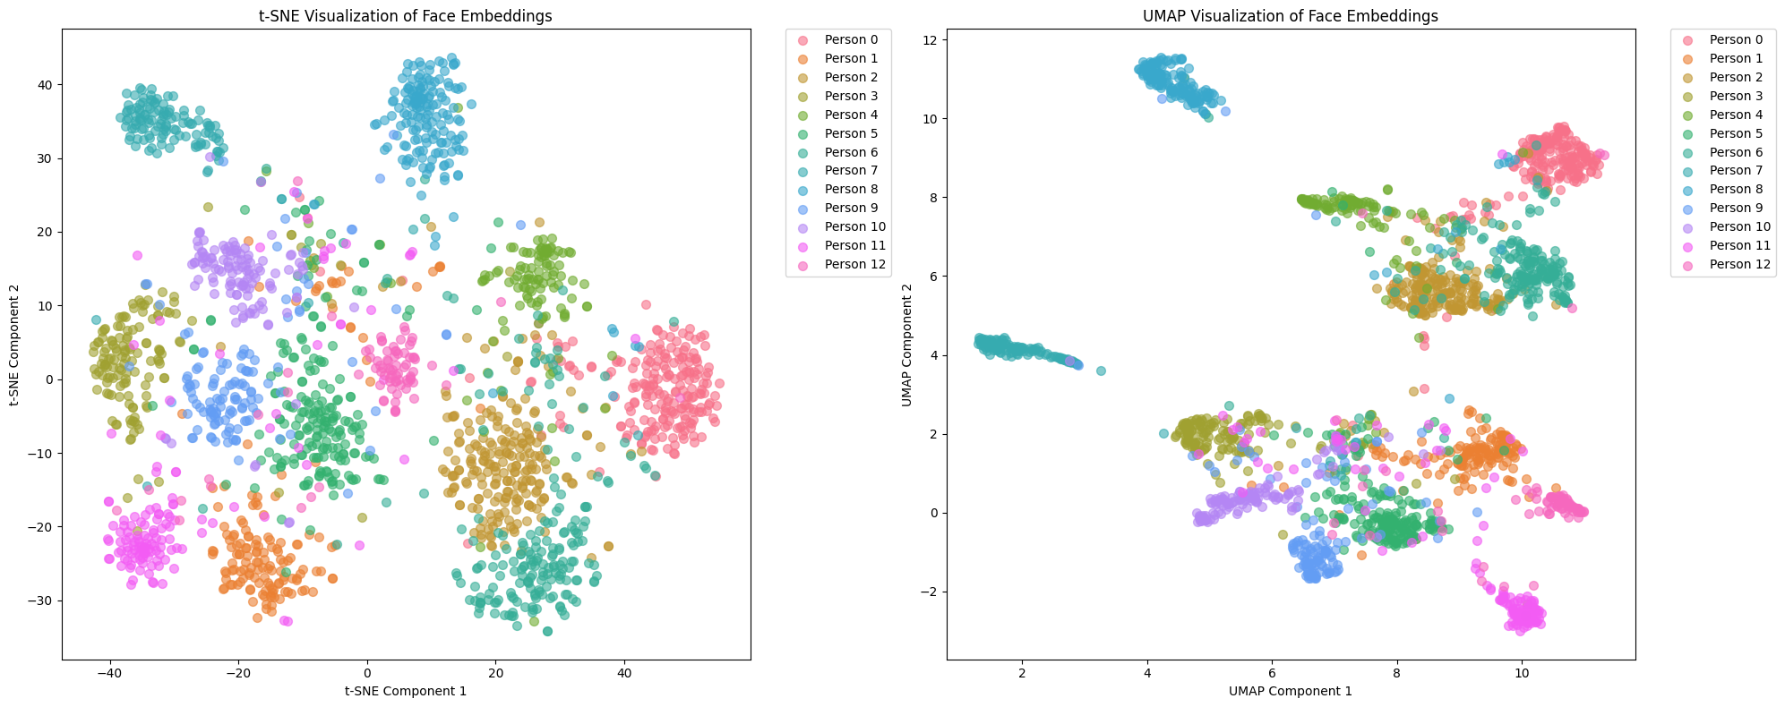

Slide 16
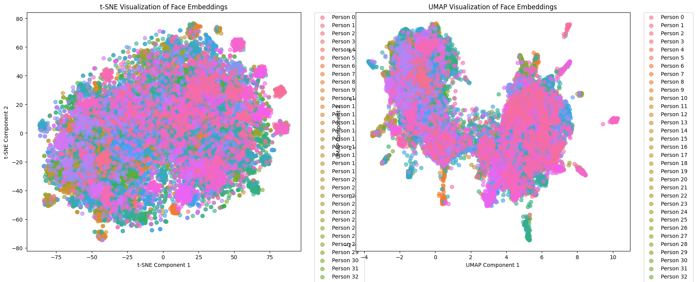

Slide 17
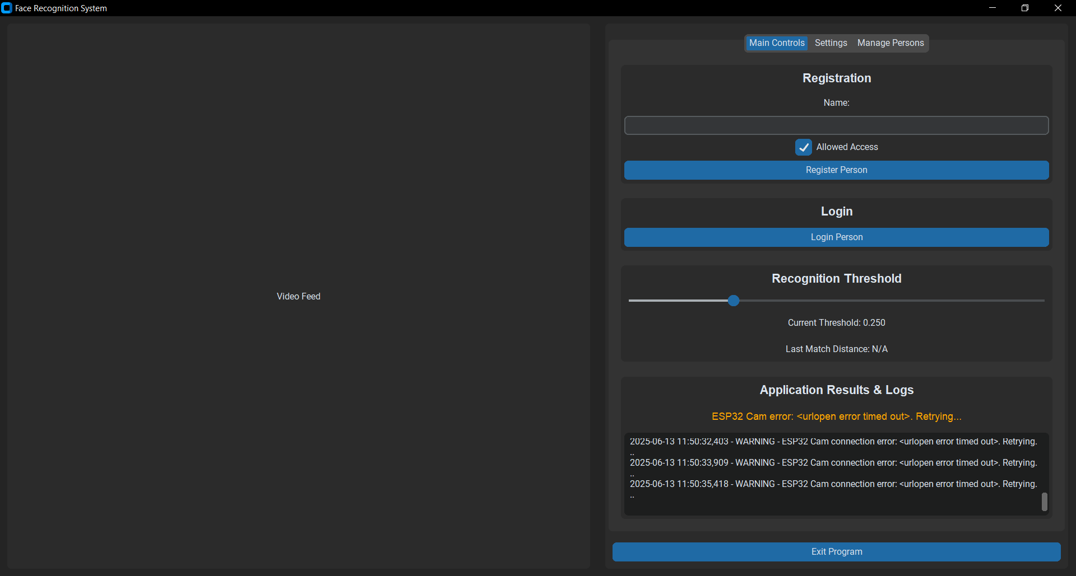
The User Interface: Main Controls
The main tab provides all core operational controls.
Actions: Buttons for "Login Person" and "Register New Person."
Live Feed: Real-time video from the selected camera.
Threshold Slider: Allows dynamic adjustment of recognition sensitivity.
Status & Logs: An area for real-time feedback, including recognition results, match distance, and system messages.

Slide 18
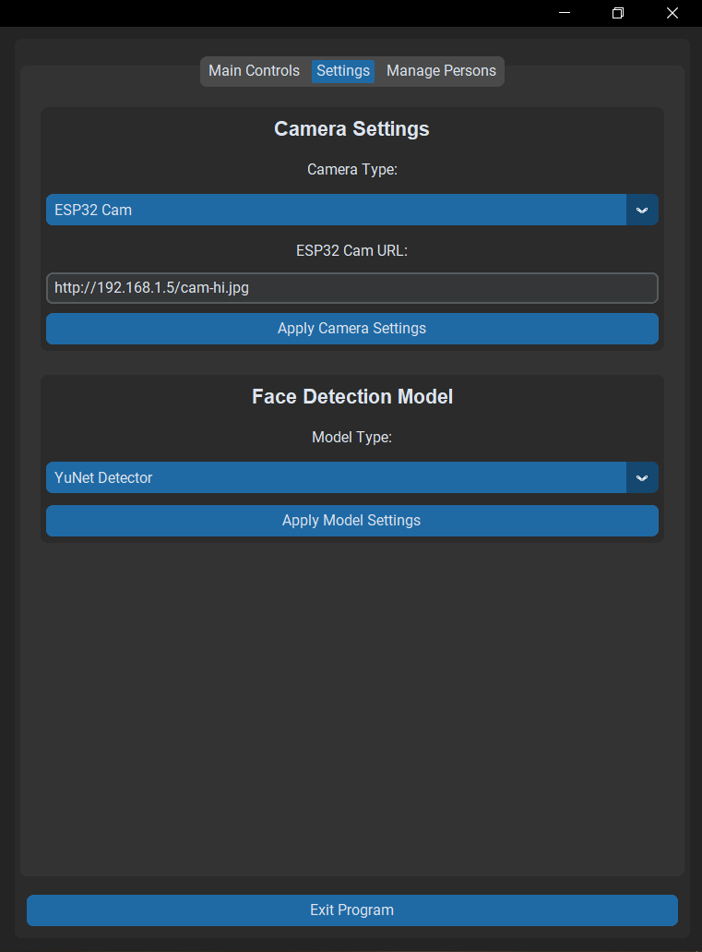
The User Interface: Settings Tab
This tab allows for on-the-fly system configuration.
Camera Selection: Dropdown menu to choose between "Built-in Cam" and "ESP32 Cam."
Apply Buttons: Settings are applied instantly without restarting the application.
Model Selection: Dropdown menu to switch between "YuNet," "Haar Cascade," and "Custom CNN" face detectors.

Slide 19
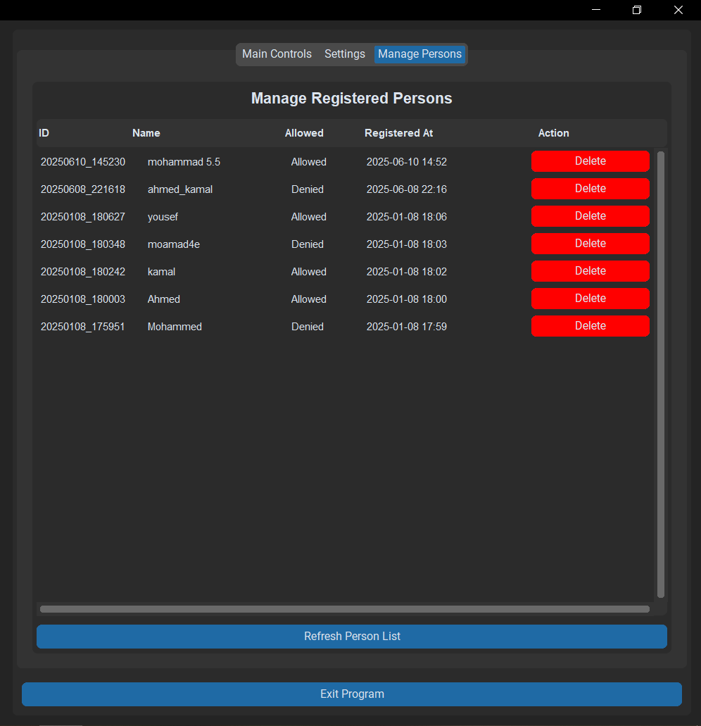
The User Interface: Manage Persons
Provides full control over the user database.
Registered List: Displays all individuals in the database with their name and access status.
Delete Functionality: Easily remove individuals from the system with a single click.
Status Indicator: Clearly shows whether a person is "Allowed" or "Not Allowed."

Slide 20
Challenges & Conclusion
Key Challenges Overcome:
Handling significant variations in lighting and camera angles.
Optimizing detector models for real-time performance.
Ensuring thread-safe database operations to prevent the GUI from freezing during I/O tasks.
Conclusion:
We successfully developed a robust, flexible, and user-friendly real-time facial recognition system that met all initial objectives.
The project demonstrates the effectiveness of custom-trained models, particularly with ArcFace loss, for creating highly discriminative embeddings.
The evaluation highlighted that real-world deployment success is critically dependent on the quality and balance of the underlying data.
Notes:
Accuracy: Accuracy is the ratio of correctly predicted instances (both true positives and true negatives) to the total instances in the dataset. It measures the overall correctness of the model.
Precision: Precision is the ratio of true positive predictions to the total predicted positives (true positives plus false positives). It indicates the accuracy of the positive predictions made by the model.
Recall: Recall, also known as sensitivity, is the ratio of true positive predictions to the total actual positives (true positives plus false negatives). It measures the model's ability to identify all relevant instances.
F1 Score: The F1 score is the harmonic mean of precision and recall, providing a single metric that balances both. It is particularly useful when dealing with imbalanced datasets, as it considers both false positives and false negatives.

Slide 21
Future Work
Security & Robustness:
Liveness Detection: Incorporate anti-spoofing mechanisms (e.g., blink detection, texture analysis) to prevent attacks using photos or videos.
Improve Dataset Quality: Augment the training data with more diverse and balanced identities to enhance generalization.
Performance and Deployment:
Performance Optimization: Implement GPU acceleration (CUDA) and explore model compression techniques like quantization and pruning for deployment on edge devices (e.g., Raspberry Pi, Jetson Nano).
Standalone Application: Package the system into a standalone executable for easier distribution and use.
Model & Feature Expansion:
Advanced Models: Add support for state-of-the-art detection models like RetinaFace and investigate newer loss functions such as CurricularFace.
Multi-Face Support: Extend the pipeline to detect and track multiple faces within a single frame.
Cloud Integration: Connect the database to a cloud service to enable remote management and synchronization across multiple devices.

Slide 22
Thank You

